Slide 1
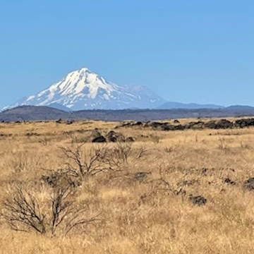
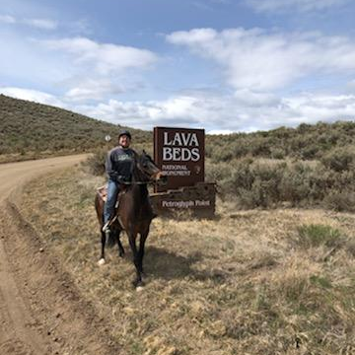
Modoc County “Where The West Still Lives”
https://www.co.modoc.ca.us/
Presented by Jackie Froeming,
Associate Planner

Slide 2
Quick Facts on Modoc County
Established in 1874
4200 Square Miles
City of Alturas is the only incorporated area and the county seat.
Very sparsely populated.
The population has declined by 10% since 2010. The current population is approximately 8700.
Surrounded by Federal Lands

Slide 3
Map of Modoc County

Slide 4
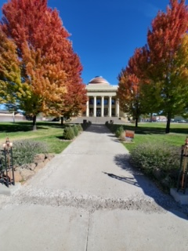
Economy and Lifestyle
“ Modoc County is a collaborative community where people, families, governments, and businesses live, work, and thrive”.
Largest employers:
Modoc County
U.S. Forest Service
Cal Fire
California Highway Patrol
City of Alturas, and local businesses
Various agricultural operations
Economic Development is a challenge in rural communities due to limited resources.

Slide 5
How GIS can help the community.
Provide the ability to map infrastructure such as well locations, septic systems, etc.
Provide public information online such as zoning, general plan, roads, etc.
Mapping of historical sites and points of interest.
Vacant land inventory map

Slide 6
GIS Challenges in Modoc County
The current data needs to be updated and organized
Funding
Limited Staffing
Training staff to use GIS

Slide 7
Future GIS direction and growth
Moving to ArcGIS Online
Updating and Organizing current information
Building a Geodatabase with updated information
Centrally locate current GIS information for easier access
Moving towards a public-facing GIS system.

Slide 8
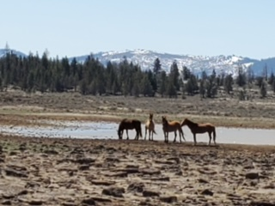
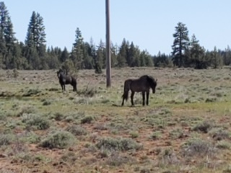
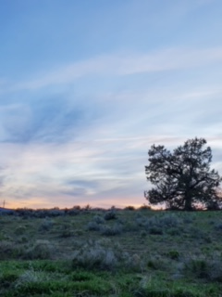
Websites with additional information on Modoc County
https://www.census.gov/quickfacts/fact/table/modoccountycalifornia/INC110222
https://www.destinationmodoc.org/

