Slide 1
3D Elevation Program (3DEP) Ramping up for FY17 funding grants
Drew Decker & Carol Ostergren
USGS National Geospatial Program (NGP)
Sept. 7, 2016

Slide 2
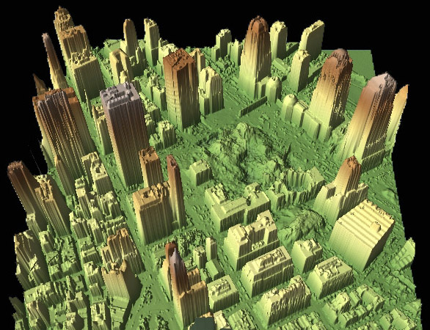
3D Elevation Program (3DEP)
Applies ground-breaking lidar technology to acquire and distribute 3D data
Addresses a broad range of critical applications of national significance
3D data include surface elevations and natural and constructed features
3DEP increases the quality level of lidar being acquired to enable more accurate understanding, modeling, and prediction
Goal to acquire national coverage in 8 years
Notes:
You may be familiar with the long history of the USGS in providing elevation data, first through contours on our topographic maps and later by digital data in the National Elevation Dataset.
The 3D Elevation Program is our newest effort to provide national elevation data.
We believe this program is transformational because it applies ground-breaking lidar data to provide not only a higher resolution bare earth elevation surface, but it also provides us with 3-dimensional data of all the natural and constructed features. These data are transforming industries and creating new applications never before possible.
The program also calls for increasing the quality level of lidar data being acquired because it meets many more mission critical applications.
Our goal is to acquire national lidar coverage in 8 years, with ifsar data in Alaska.

Slide 3
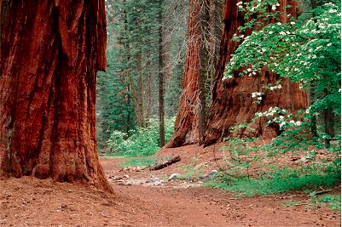
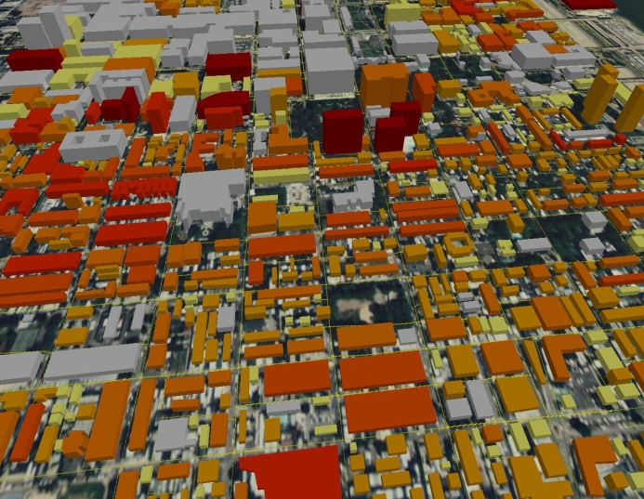
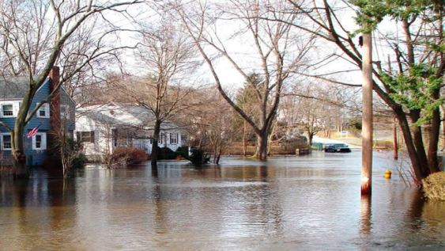
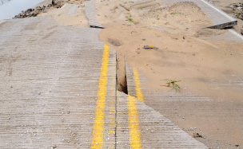
What is the 3D Elevation Program?
3DEP is a call for community action to…
Address the mission-critical requirements of 34 Federal agencies, 50 states, and a sampling of local governments, tribes, private and not‐for profit organizations documented in the National Enhanced Elevation Assessment
Return more than $690 million annually in new benefits, ROI = 5:1
Leverage collaboration among Federal, states, local and tribal partners to systematically complete national 3D data coverage in 8 years
Leverage the capability of private industry mapping firms, create jobs
Achieve a 25% cost efficiency gain by collecting data in larger projects
Completely refresh national elevation data holdings with new lidar and ifsar elevation data products and services
Natural Resource Conservation
Infrastructure Management
Flood Risk Mitigation
Precision Farming
Land Navigation
and Safety
Geologic Resources and Hazards Mitigation
Notes:
We like to call 3DEP a call for community action because it is an effort to address more than 600 mission-critical needs that were reported by 34 Federal agencies, 50 states, and a sampling of other organizations and documented in the National Enhanced Elevation Assessment of 2012.
3DEP is designed to provide a 5 to 1 return on investment and a conservative dollar benefit of more than 690 million dollars annually if implemented in 8 years.
3DEP is also a call for community action because it is a partnership that depends on the collaboration of Federal, state, local, tribal and other partners to fund the data acquisition.
3DEP leverages the expertise and capacity of the private sector mapping firms that acquire the data for us through the USGS Geospatial Products and Services Contract, and through partner acquisitions.
By acquiring data in larger project areas, 3DEP will help all of the partners realize a cost efficiency gain we estimate to be about 25% lower costs.
And of course we will completely refresh our publicly available, national data holdings to replace the patchwork of quality and sources with consistent, new lidar and ifsar data products and services. In 2015 the program began delivering these new products and services through The National Map.

Slide 4
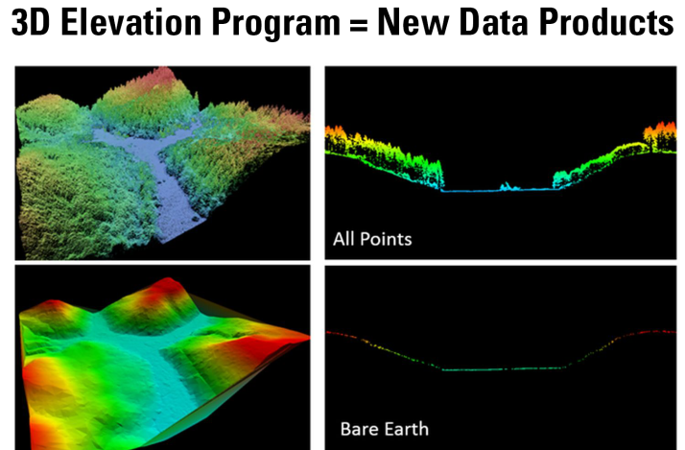
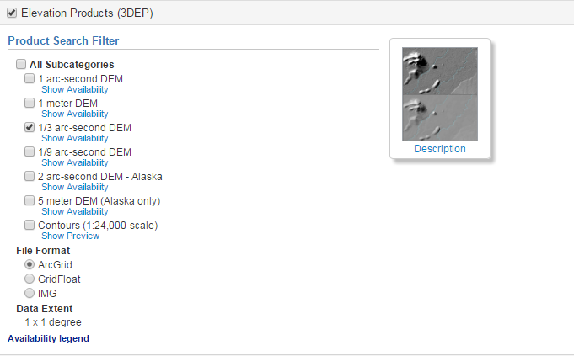
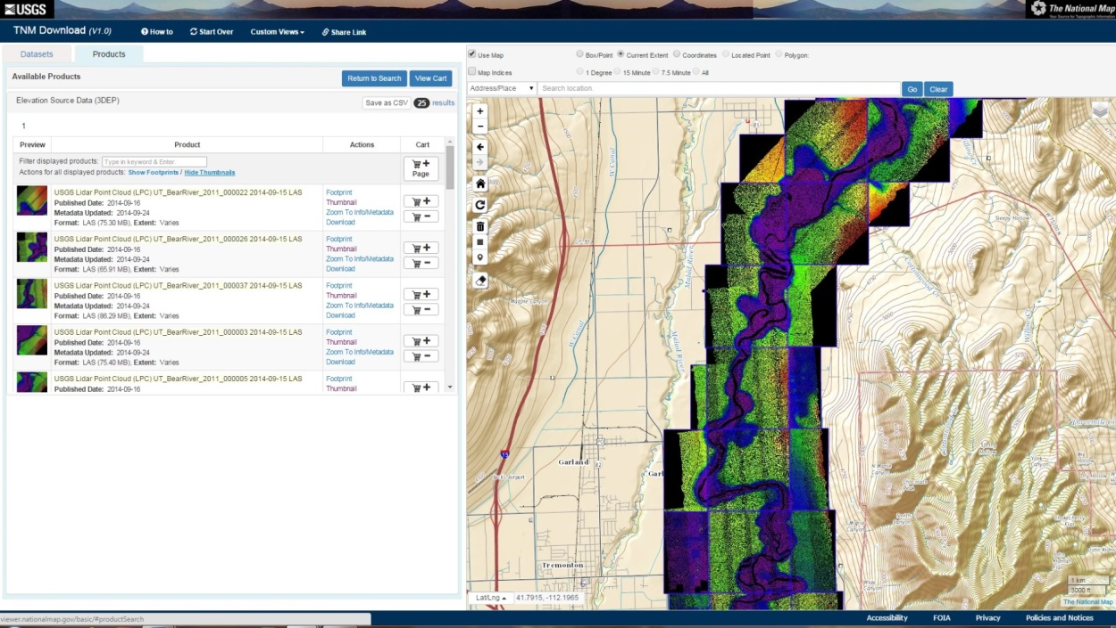
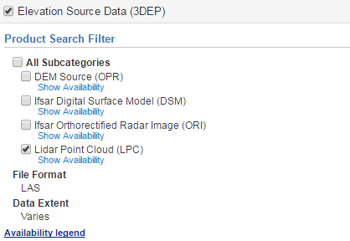
3DEP Products and Services
The National Map
nationalmap.gov/3DEP
Notes:
Reminder, where to find lidar data

Slide 5
Helpful tools

Slide 6
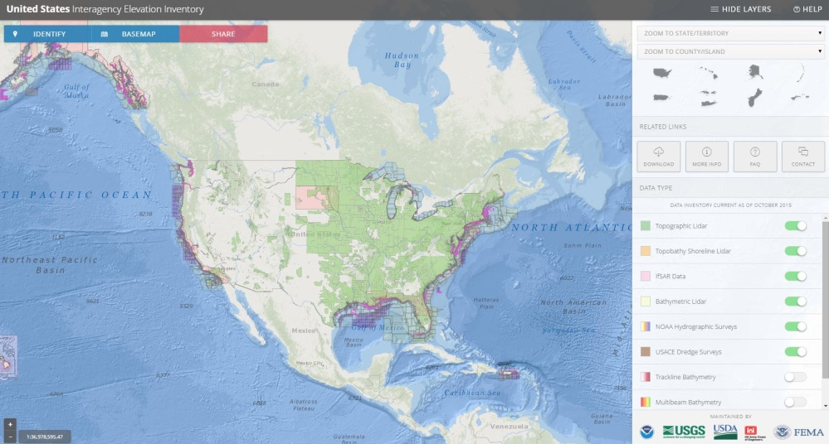
Where has lidar data been collected?
U.S. Interagency Elevation Inventory
Interagency Collaboration
USGS leads the topographic component by leveraging on-the-landscape knowledge of the USGS National Map liaison network
NOAA (Bathy-Lead), FEMA, USACE, USFS, NRCS, NPS
Improves understanding of the nation’s lidar landscape
Active updates are critical to assessing progress toward 3DEP goals
www.coast.noaa.gov/inventory
Notes:
www.csc.noaa.gov/inventory

Slide 7
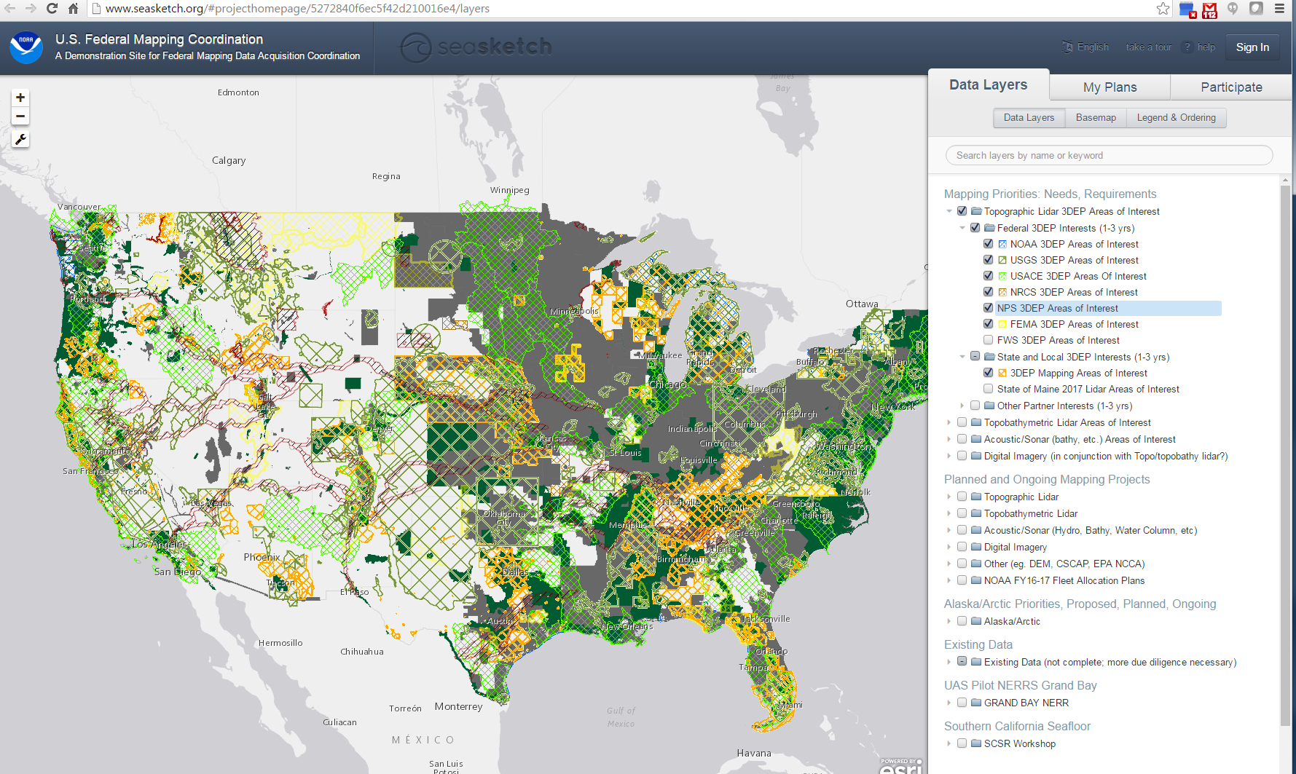
Where do people want to collect data?
Analysis Tool: Interagency Areas of Interest – Seasketch
Seasketch - http://seasket.ch/hwpR3E-MxO

Slide 8
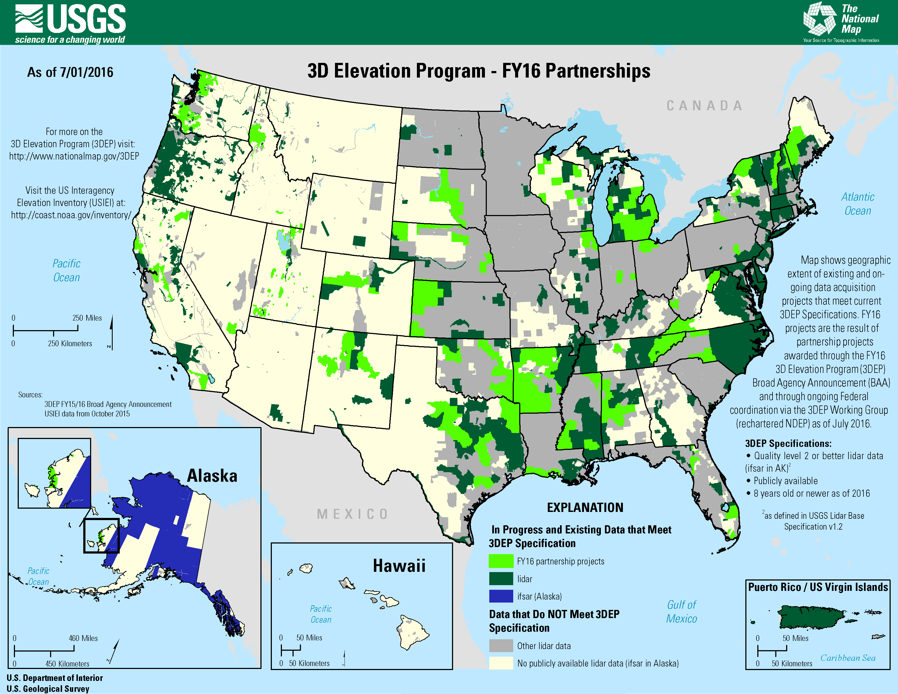
FY16 3DEP Partnerships

Slide 9
Importance of Data Acquisition Coordination

Slide 10
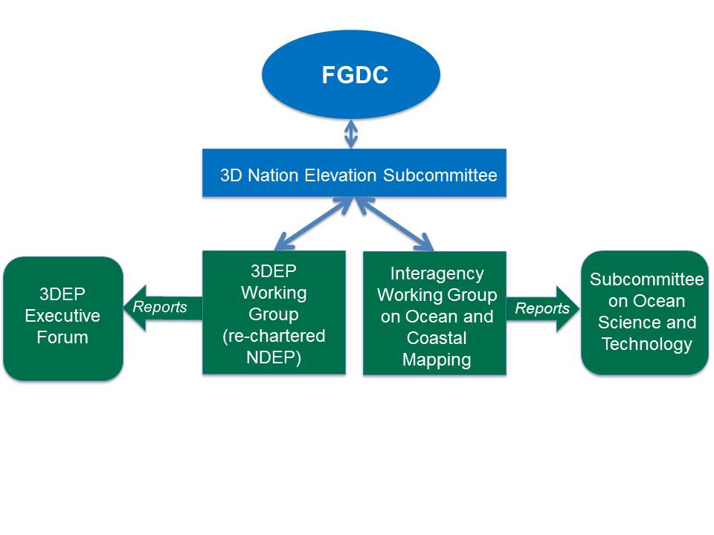
3DEP Data Acquisition
Broad Agency Announcement (BAA)
Detailed info on how to partner with the USGS & other Federal agencies to acquire 3DEP quality data
Systematic, transparent process for non-Federal agencies to partner with Federal agencies – anyone is eligible to submit proposals
Announced at Fed Biz Opps and Grants.gov
Two Project Proposal options :
Contribute funds to acquire data using the USGS Geospatial Products and Services Contracts
Request 3DEP funds to acquire data using the partner’s contract
Augmented with additional Federal investments throughout the year
Overall process managed by the interagency 3DEP Working Group
18 Member Interagency Coordination

Slide 11
3DEP FY17 BAA Timeline
National
Public Webinars: Aug 11 and 15
Federal Agencies Submit Areas of Interest
Federal 3DEP Partners Review Proposals
BAA Released
April | May | June | July | Aug | Sept | Oct | Nov | Dec | Jan | Feb | March
Other Stakeholders Submit Areas of Interest
Stakeholders Submit Proposals
Selections Announced
State/Regional
Public Meetings/Workshops
BAA Contract and Grant Administration
BAA Project Execution

Slide 12
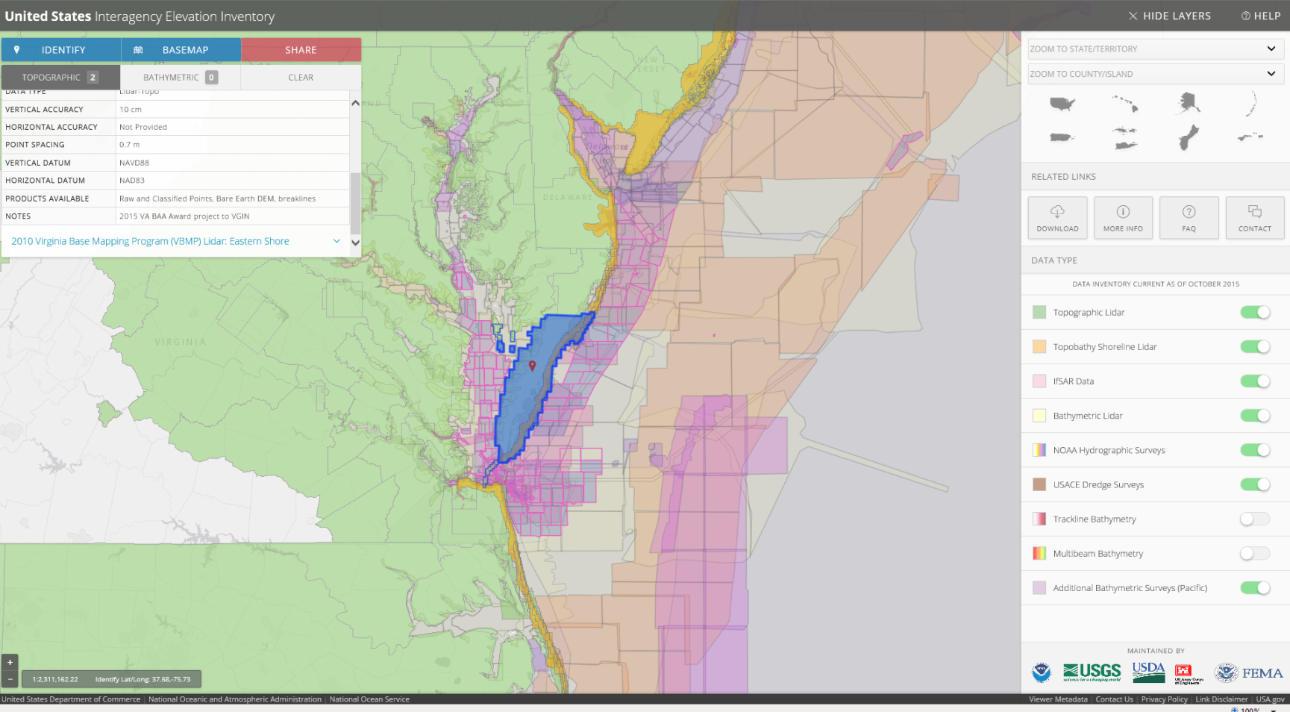
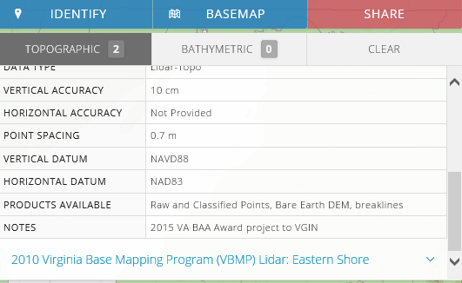
Step 1: Check if data already exist
The US Interagency Elevation Inventory - https://coast.noaa.gov/inventory/
Check if data already exist
Coordinate with others
PLAN for data acquisition
Socialize your project and seek partners

Slide 13
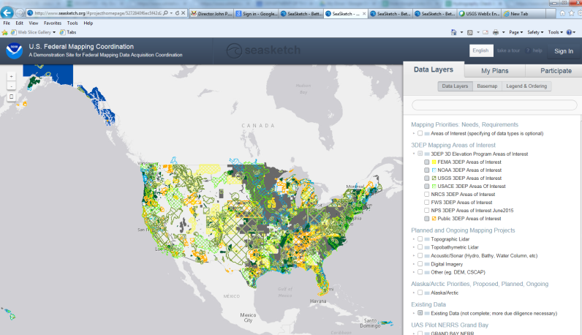
Step 2: Coordinate with others
Share your Area of Interest on Seasketch
Visit cms.geoplatform.gov/elevation/3DEP/View3DEPAOI
Submit your area of interest
Federal Agency Process:
Contact your agency’s 3DEP Working Group Member
For instructions on how to add your area of interest to your agency’s consolidated requirements
Receive guidance on your agency’s acquisition process
Enlist your agency working group member to socialize the project at the national level in the 3DEP Working Group
If you do not know who your 3DEP WG member is contact 3DEP@usgs.gov
Check if data already exist
Coordinate with others
PLAN for data acquisition
Socialize your project and seek partners
Notes:
https://cms.geoplatform.gov/elevation/3DEP/View3DEPAOI

Slide 14
Step 3: Socialize your project and Seek partners
Contact your USGS National Map Liaison to learn about upcoming coordination meetings and other resources
Use the Seasketch site to find potential partners within or adjacent to your area of interest
Participate in 3DEP Meetings and Workshops
If you have funding you would like to invest in data acquisition, contact potential partners and define a joint project to leverage funding
Check if data already exist
Coordinate with others
PLAN for data acquisition
Socialize your project and seek partners

Slide 15
Step 4: Plan for Data Acquisition
Submit a proposal to receive 3DEP funding for your project
Use the USGS Geospatial Products and Services Contracts (GPSC) to acquire data with the funding you and your partners currently have available
Contribute data that meet 3DEP Specifications to the national 3DEP holdings
Federal Agencies should work with their 3DEP Working Group member to explore all 3DEP acquisition options available within their agency.
Questions or assistance on any of the above? Ask 3DEP: 3DEP@usgs.gov
Check if data already exist
Coordinate with others
PLAN for data acquisition
Socialize your project and seek partners

Slide 16
What will YOU do with 3DEP data?
Share applications and encourage innovation
Share your 3DEP data story:
nationalmap.gov/3DEP Click on Contact Us
Have you used 3DEP data?
How do you plan to use 3DEP data?

Slide 17
Become a part of 3DEP
Coordinate
Share your lidar requirements
Partner
Through 3DEP for new acquisitions
Promote
Participation to increase economies of scale
Contribute
Ensure lidar data investments meet 3DEP specifications and contribute to 3DEP holdings
Engage
Provide input to help refine and evolve the process to meet your needs
Showcase
Share your lidar applications

Slide 18
3D Elevation Program (3DEP)
3D Elevation Program (3DEP) FY15/16 Broad Agency Announcement (BAA) Information Sharing Site https://cms.geoplatform.gov/elevation/3DEP
3D Elevation Program (3DEP): Watch the recorded helpful public meeting
https://cms.geoplatform.gov/elevation/3DEP/PublicMeetings
Find the fed biz ops announcement
https://www.fbo.gov/index?s=opportunity&mode=form&id=265096b44d04d55e01105ae585fbc0cb&tab=core&_cview=1
Find the grants.gov announcement:
http://www.grants.gov/web/grants/search-grants.html?keywords=usgs%203dep
The 3D Elevation Program Initiative – A Call for Action http://pubs.usgs.gov/circ/1399/
The Seasketch viewer http://www.seasketch.org/#projecthomepage/5272840f6ec5f42d210016e4
To upload your own requirement into seasketch https://survey.geoplatform.gov/index.php/994421/lang-en#
USGS NGP Lidar Base Specification V1.2
http://pubs.usgs.gov/tm/11b4/pdf/tm11-B4.pdf
For Further Information Contact: 3D Elevation Program:
gs_baa@usgs.gov
For partnership staff:
http://liaisons.usgs.gov/geospatial/documents/TNM_Partnership_User_ContactList.pdf
Carol Ostergren (CA and NV) U.S. Geological Survey National Geospatial Program CSUS—Placer Hall 6000 J Street Sacramento, CA 95819-6129 916-278-9510 costergren@usgs.gov
Drew Decker
National Map Liaison for Pacific Region
U.S. Geological Survey
4165 Spruance Road
San Diego, CA 92101
619-225-6430
619-417-2879 cell
ddecker@usgs.gov

Slide 19
….if you are federal….
Agency | 3DEP WG Primary Member | Email
Bureau of Land Management | Brian Hadley | bchadley@blm.gov
Department of Homeland Security | Scott McAfee | scott.mcafee@dhs.gov
Department of Transportation | Michael Traffalis | michael.traffalis@dot.gov
Environmental Protection Agency | Harvey Simon | simon.harvey@epa.gov
Federal Aviation Administration | Joseph Jackson | joseph.a.jackson@faa.gov
Federal Communications Commission | Donald Campbell | donald.campbell@fcc.gov
Federal Emergency Management Agency | Paul Rooney | paul.rooney@dhs.gov
US Forest Service | Everett Hinkley | ehinkley@fs.fed.us
US Fish and Wildlife Service | Kenneth Elsner | kenneth_elsner@fws.gov
National Oceanic and Atmospheric Administration | Kirk Waters | kirk.waters@noaa.gov
National Park Service | Seshu Vaddey | seshu_vaddey@nps.gov
Natural Resources Conservation Service | Steven Nechero | steven.nechero@ftw.usda.gov
Office of Surface Mining Reclamation and Enforcement | Kamiliah Pendleton | klograsso@osmre.gov
US Department of Agriculture | Brian Vanderbilt | brian.vanderbilt@slc.usda.gov
US Army Corps of Engineers | Nancy Blyler | nancy.j.blyler@hq02.usace.army.mil
US Geological Survey | Diane Eldridge | deldridge@usgs.gov
American Association of State Geologists | Harvey Thorliefson | thorleif@umn.edu
National States Geographic Information Council | Phil Worrall | pworrall@igic.org

Slide 20
Know before you go
Resources available on nationalmap.gov/3DEP
Ask questions via Contact Us
Share applications via Contact Us on 3DEP Website
Carol and Drew: your 3DEP go-to team
Thank you!

